Slide 1

AGM 2024
Challenger Society for Marine Science
18th September 2024

Slide 2
Council Members from Sept 2023
Officers of Council
Mike Meredith President
Maeve Lohan Incoming President
Ed Mawji/Alex Brearley Treasurer
Kate Hendry Secretary
Co-opted members
Angela Colling Ocean Challenge editor
Stephen Dye Chair OC editorial board
Kerry Howell SCOR/Deep Sea SIG
Nick Owens 2024 conference chair
Gillian Damerell EDI
Ben Fisher EDI
Council members
John Allen Challenger Wave editor
Cecilia Liszka SIGs
John Bacon Webpage
Siddhi Joshi ECR
Chelsey Baker Membership
Anna McGregor Media and communications
Terry Sloane Industry liaison
Al Tagliabue SCOR
Mark Inall Chair of NOC-A
Robyn Tuerena Outreach and Education
Sophie Wilmes Travel awards and Stepping Stones bursaries
Notes:
Mattias to update

Slide 3
Agenda
Approval of minutes from the AGM in September 2023
Matters arising from minutes of the 2023 AGM
President’s Report
Portfolio reports
Treasurer’s report and accounts
Appointment of auditors for Independent Financial Review
Election of new Council Members
AOB

Slide 4

Approval of minutes of previous the AGM, September 2023
http://www.challenger-society.org.uk/Annual_General
Proposer: Terry Sloane Seconder: Cecilia Liszka
Notes:
Mattias to update

Slide 5
2. Matters Arising
No matters arising

Slide 6
3. President’s Report - AGM 2024
Prof Mike Meredith

Slide 7

President’s Report
Working towards finalisation and publication of strategy
All of Council participated, plus co-opted members from outside
Sets vision and direction for next 5 years; can be refreshed as needed
Participation in Future Marine Research Initiative (FMRI)
President sits on FMRI Board; engaged in Options meetings, Board decisions etc.
Challenger Policy Rep sits on FMRI Delivery Board
Completion of Upscaling Autonomy Working Group (UAWG) report
Joint with NOCA and MFP; led by Mark Inall
Engagement with All-Party Parliamentary Group (APPG) on the Ocean
Representing Society at Westminster events relating to marine geoengineering, future of ocean technology etc.
Represent Society at NOC Association Board meetings
Discussions with partner Societies re scaling up joint activities
includes RMetS, TOS, IES etc.
Chairing Council meetings etc.

Slide 8
4. Portfolio reports

Slide 9
4. Portfolio reports
Comms

Slide 10
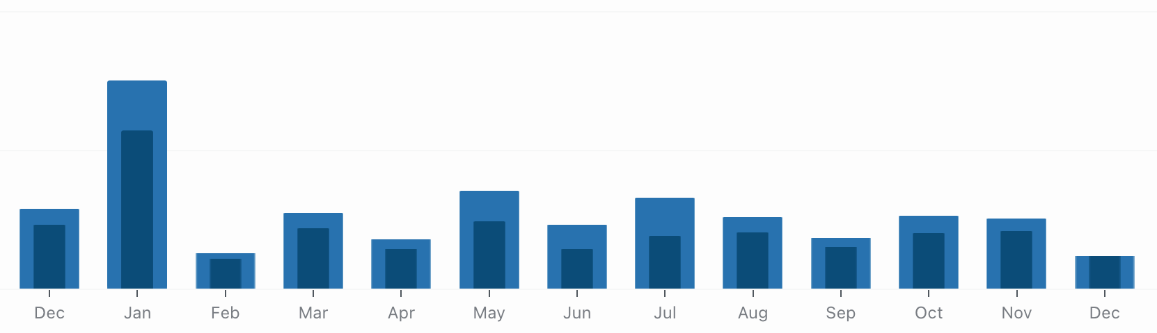
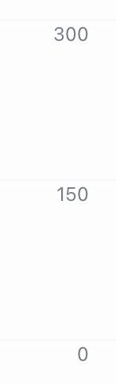
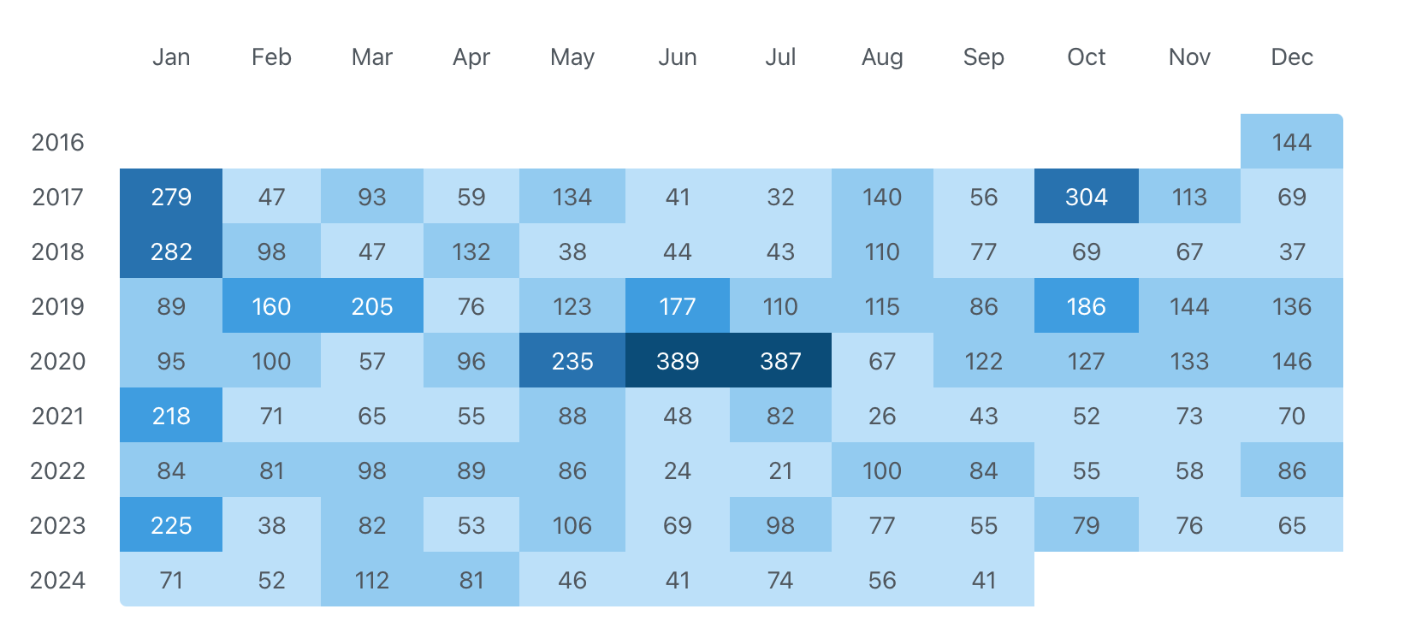
COMMUNICATIONS
Anna McGregor
Captain’s Blog
Twitter (@challengersoc)
LinkedIn page: start Nov 2023
Followers: 5133
↑272 followers from 2022
Linkedin: ~450 impressions/month
Blog: 11 posts published

Slide 11
4. Portfolio reports
UK SCOR

Slide 12

SCOR
UK continues to play a key role in SCOR
600 scientists from 60 countries participate in SCOR activities
8 current working groups are chaired by UK scientists
Three new SCOR working groups approved
WG168 4D BGC: Coordinating the Development of Gridded Four-Dimensional Data Products from Biogeochemical-Argo Observations
WG169 GLUBS: Global Library of Underwater Biological Sounds
WG170 PRIMO: Physiology and Rates in Microbial Oceanography
Capacity development continued, with new visiting scholars sponsored
Ongoing links with SCAR via co sponsorship of the Southern Ocean Observing System
Challenger Society covers 51% of SCOR subscriptions and council is the UK SCOR committee
UK SCOR committee meets annually to review working group proposals and discuss strategy
Contributions to overall Challenger Society strategy developed
Partnership with the Royal Society continues to work well
UK SCOR review of Working Group applications completed, new groups to be decided at 2024 SCOR AGM in Oct

Slide 13
4. Portfolio reports
Awards

Slide 14
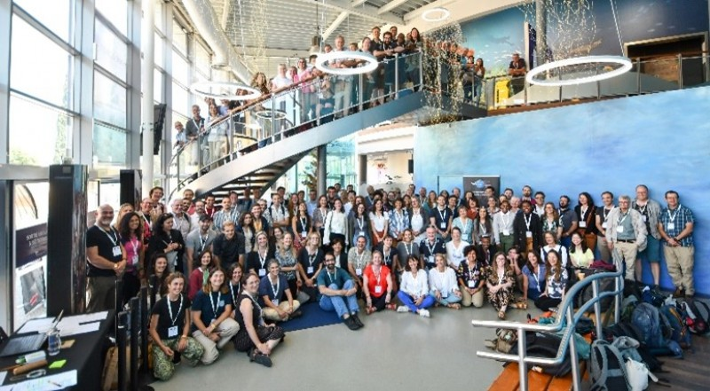
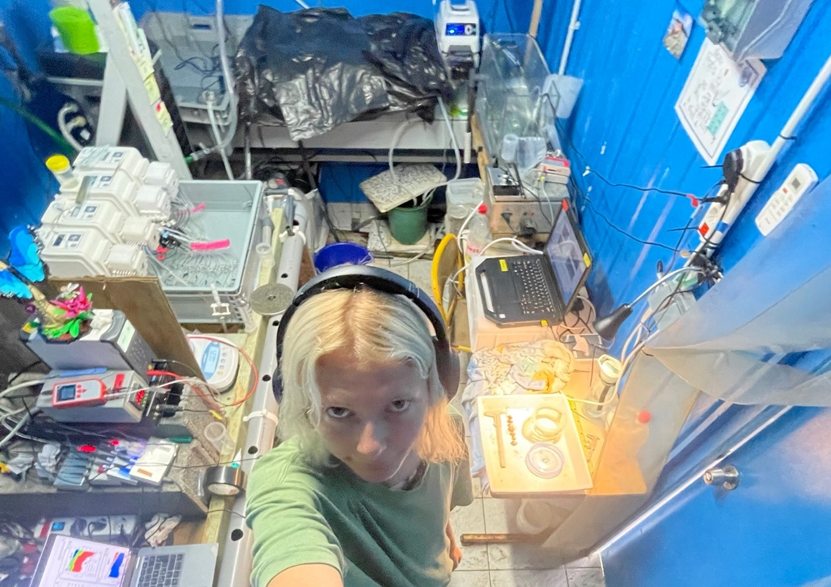
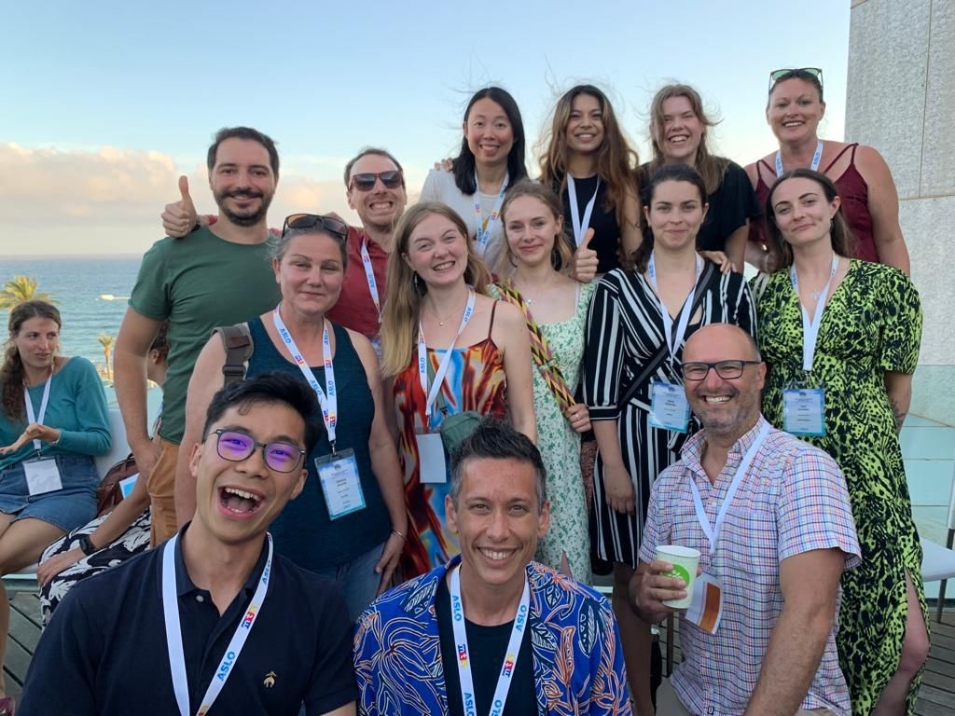
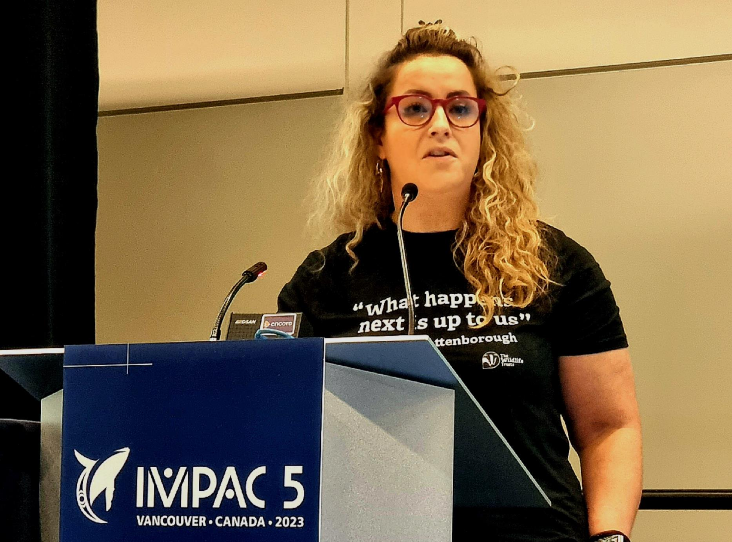
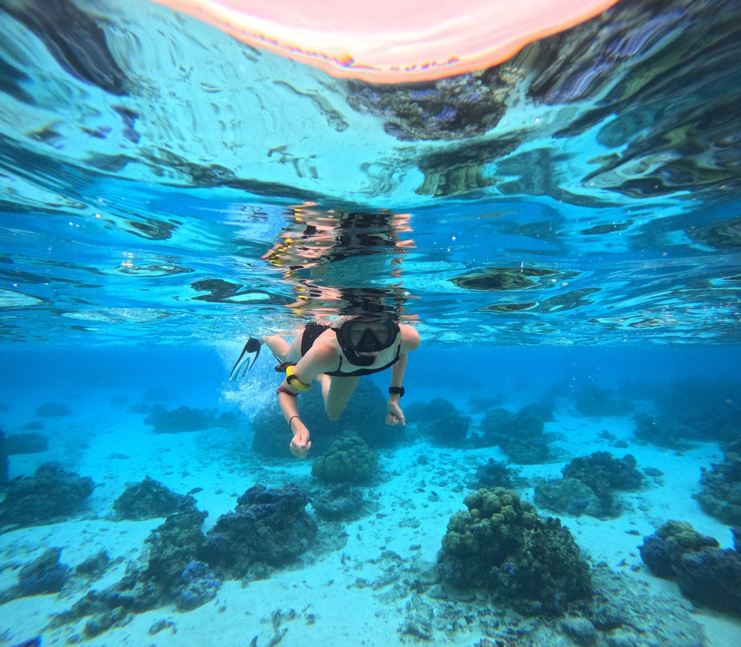
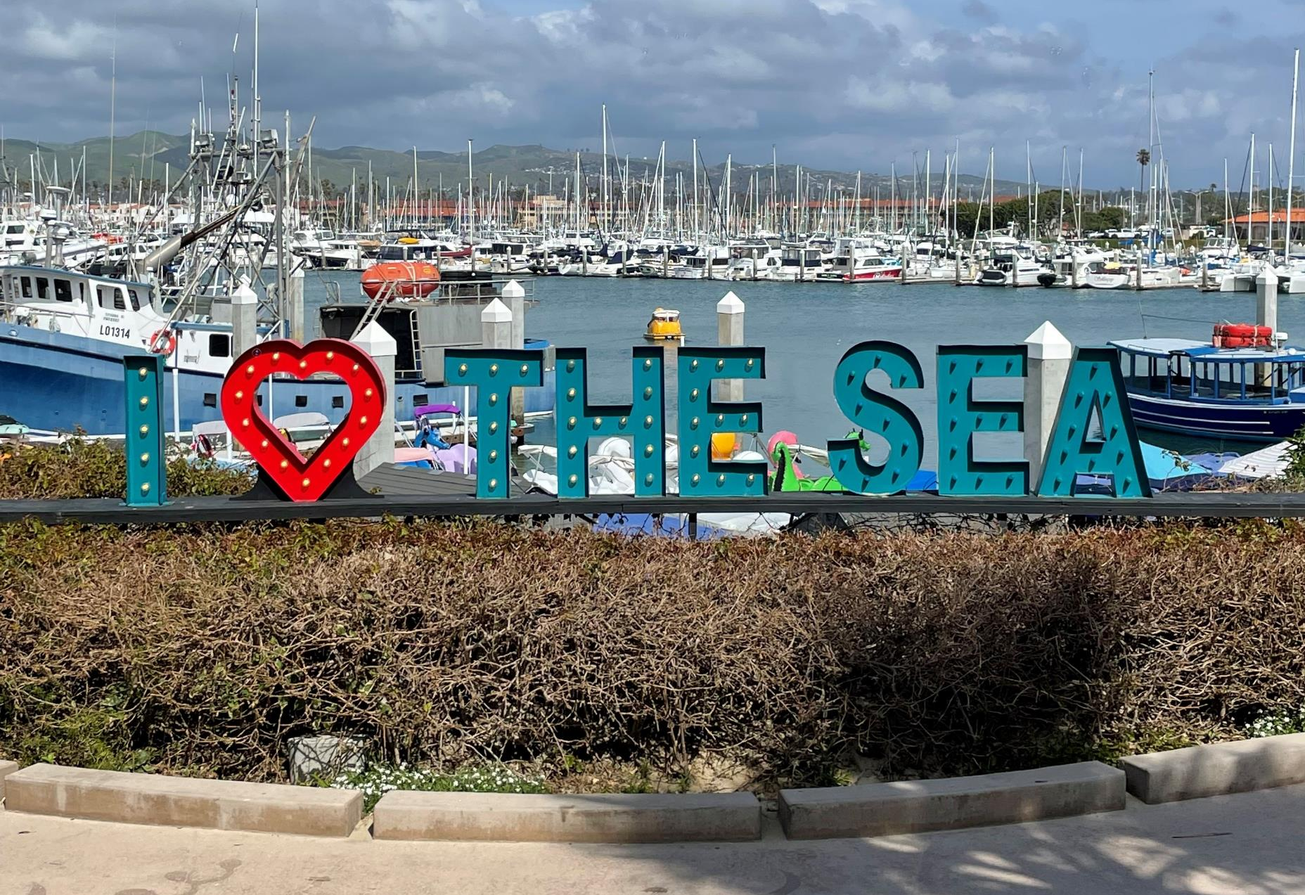
Travel Awards
Application numbers on upward trend after Covid-19
January: 5 applications – 3 funded
April: 8 applications – 3 funded
July: 12 applications – 5 funded
October: 6 applications – 5 funded
Total spend: approx. £7000
Funded activity examples:
AMBIO conference
INCISE symposium
Fieldwork in Polynesia
Research cruise to the Southern Ocean
Australian Marine Sciences Association conference
Challenger Ocean Modelling SIG Meeting 2023
International Symposium on Chemosynthesis-Based Ecosystems
Arctic Circle Assembly

Slide 15
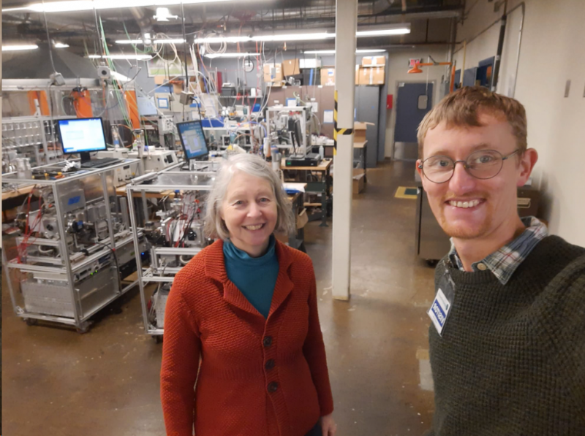
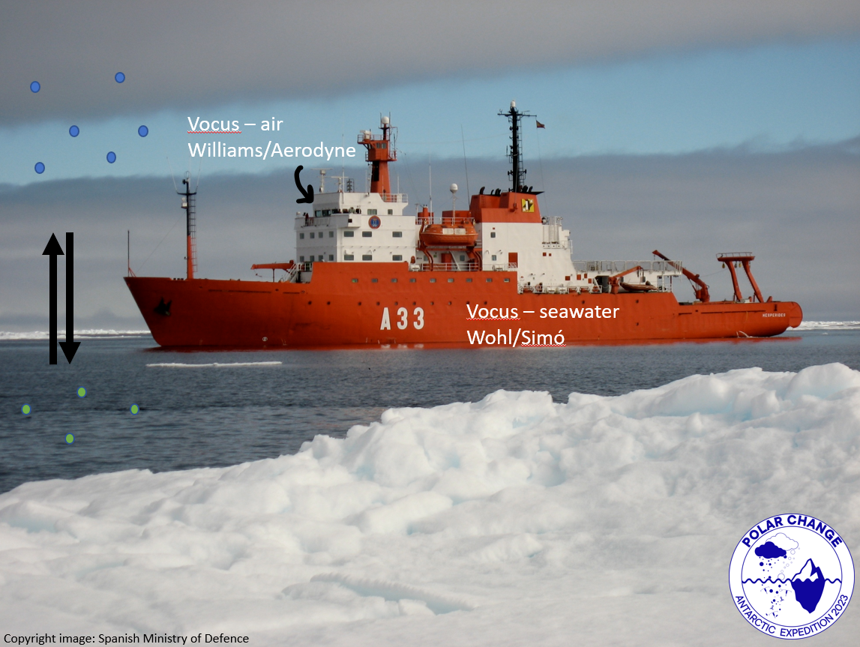
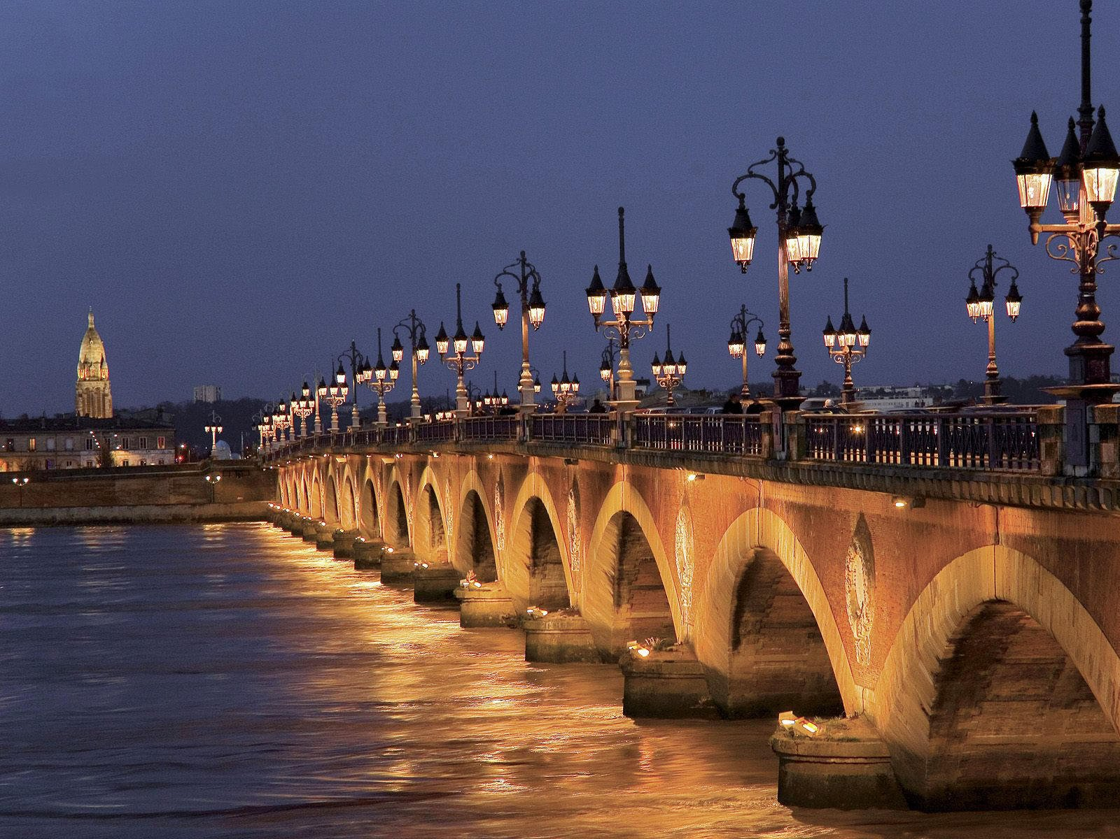
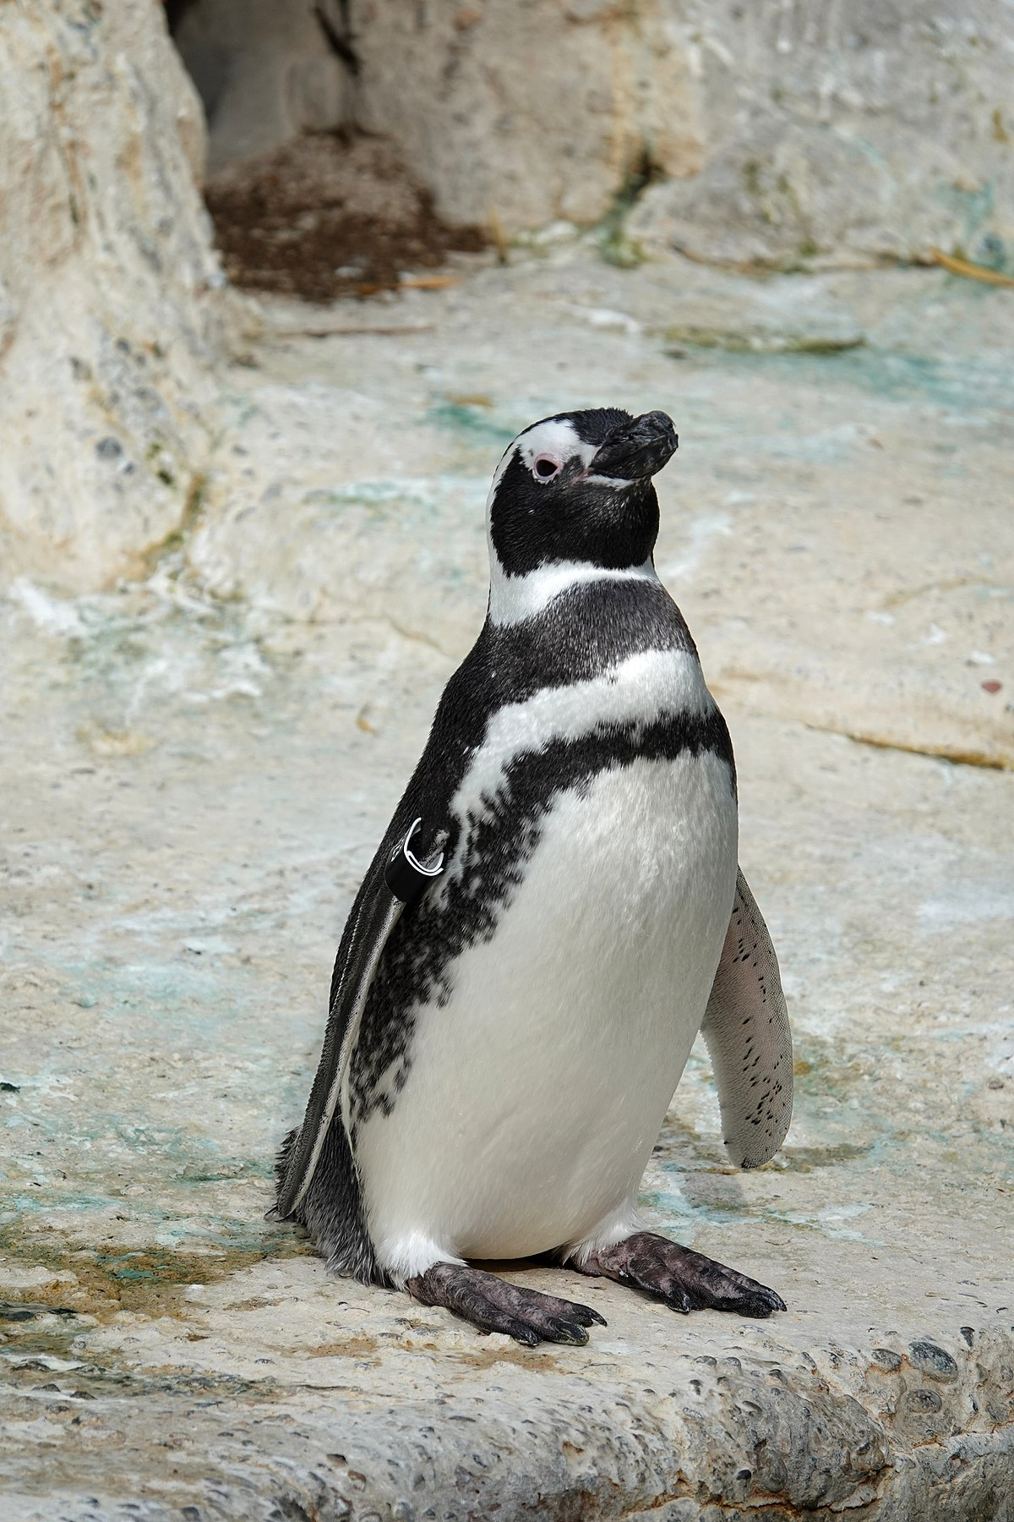
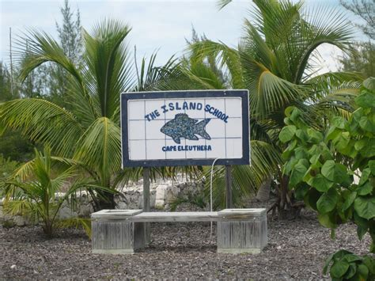
Stepping Stones Bursaries
Application numbers on an upward trend after Covid-19
6 applications, 4 successful, 1 returned (change in circumstances)
Total of £4000 awarded
Opportunities advertised on social media
Recipients:
Imogen Napper: Applied Scientific Research Course Leader at the Cape Eleuthera Island School (Bahamas)
Gui Bortolotto: Assessing Rescue from Strandings project - rehabilitation of stranded Magellan penguins
Russell Arnott: Research visit the National Institute for Agriculture, Food & Environment (INRAE), Bordeaux
Charel Wohl: Reserarch visit to Aerodyne in Boston, MA to learn more about the details of operating and analysing VOCUS – analysis of volatile organic compounds
https://upload.wikimedia.org/wikipedia/commons/thumb/7/73/Magellanic_penguin_at_SF_Zoo.jpg/1200px-Magellanic_penguin_at_SF_Zoo.jpg
https://external-content.duckduckgo.com/iu/?u=https%3A%2F%2Ftse3.mm.bing.net%2Fth%3Fid%3DOIP.tEWEIntiyXnxJruwlGF1dgHaFj%26pid%3DApi&f=1&ipt=f061cc49b49782d522024d2c0c286f3920c87a560ef176ea8b3d702e1efc2d4a&ipo=images

Slide 16
4. Portfolio reports
SIGs

Slide 17
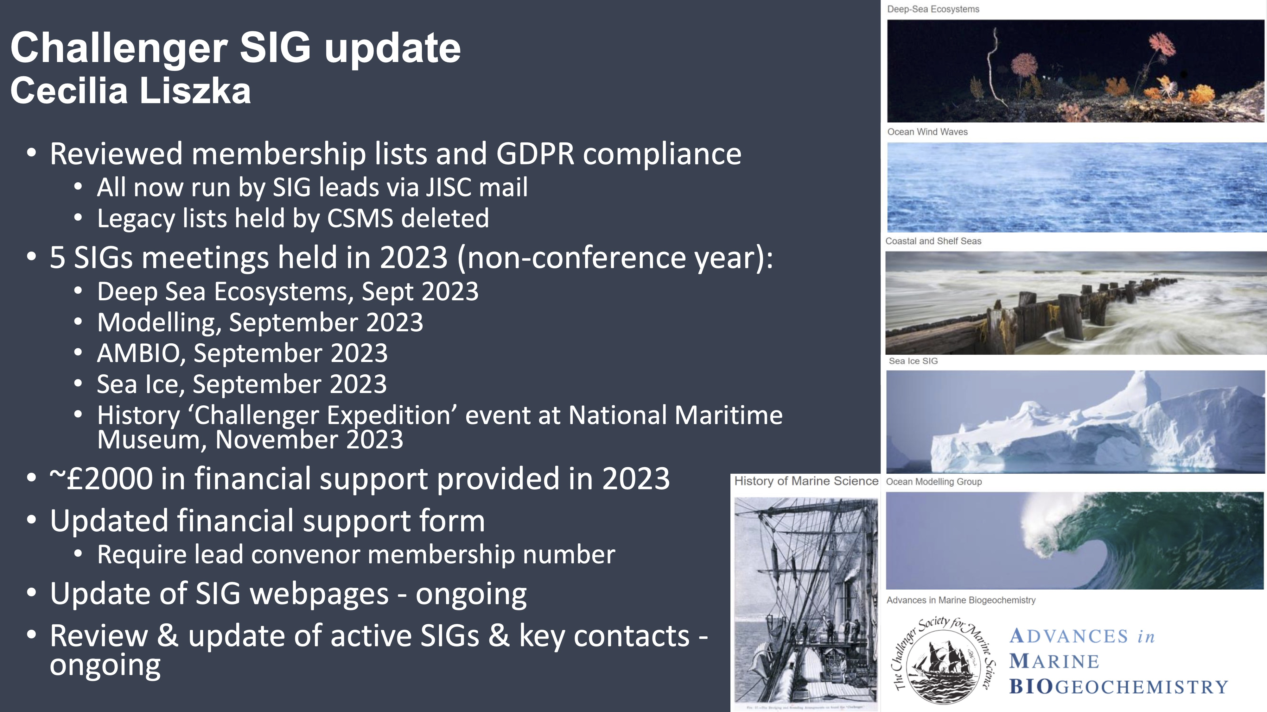

Slide 18

4. Portfolio reports
Ocean Challenge

Slide 19
Editor: Angela Colling
Editorial Board Chair: Stephen Dye
Schedule: Printed copies of Vol.26(2) went out in April 2023 and Vol.27(1) went online in late 2023 (with printed copies copies out in 2024). Barclays Bank unexpectedly closing the Society’s account meant that the printers, and people who produce artwork and design for Ocean Challenge, could not be paid promptly, but luckily they were all very understanding. The supply of copy has continued to be extremely slow, with many potential authors asking to postpone their articles because of pressure of work.
Editorial Board: The year began with Editorial Board members Laura Grange, Emma Cavan and Kelvin Boot, along with new members Megan Baker and Gillian Damerell. Later in the year, both Laura and Emma took a break from the Board and Gillian obtained a post in Norway, where she is our foreign correspondent. Thank you to them all.
Please contact Angela or Stephen if you might like to join the Editorial Board.
We had an extended Teams/email meeting over the course of two weeks in February, with lots of good ideas for future articles.

Slide 20
4. Portfolio reports
Early Career Researchers

Slide 21



Early Career Researcher Activities in 2023
Challenger Society URGE POD initiated and monthly meetings commenced from June onwards
Early Career Researcher Portfolio Holder: Dr Siddhi Joshi
Funding opportunities, tips and challenges with Challenger Society for Marine Sciences webinar
ECOP Webinar available at QR Code

Slide 22

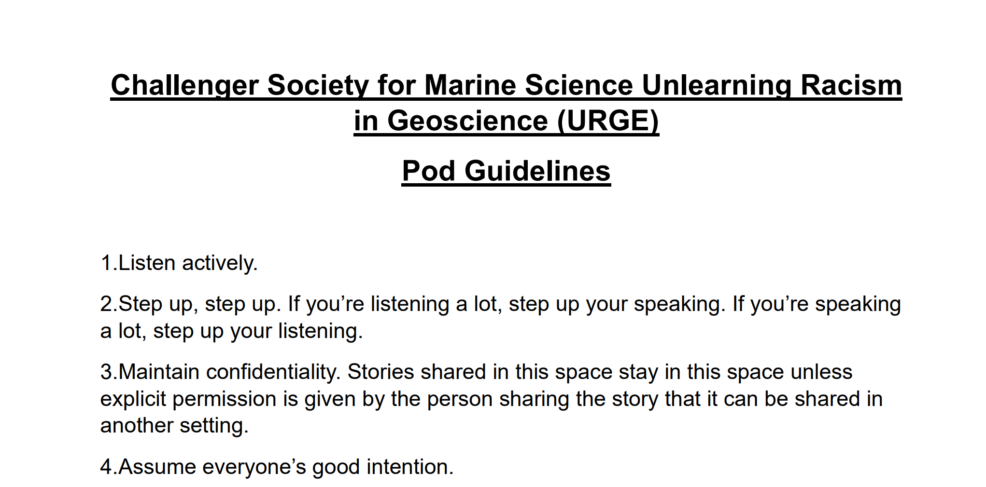
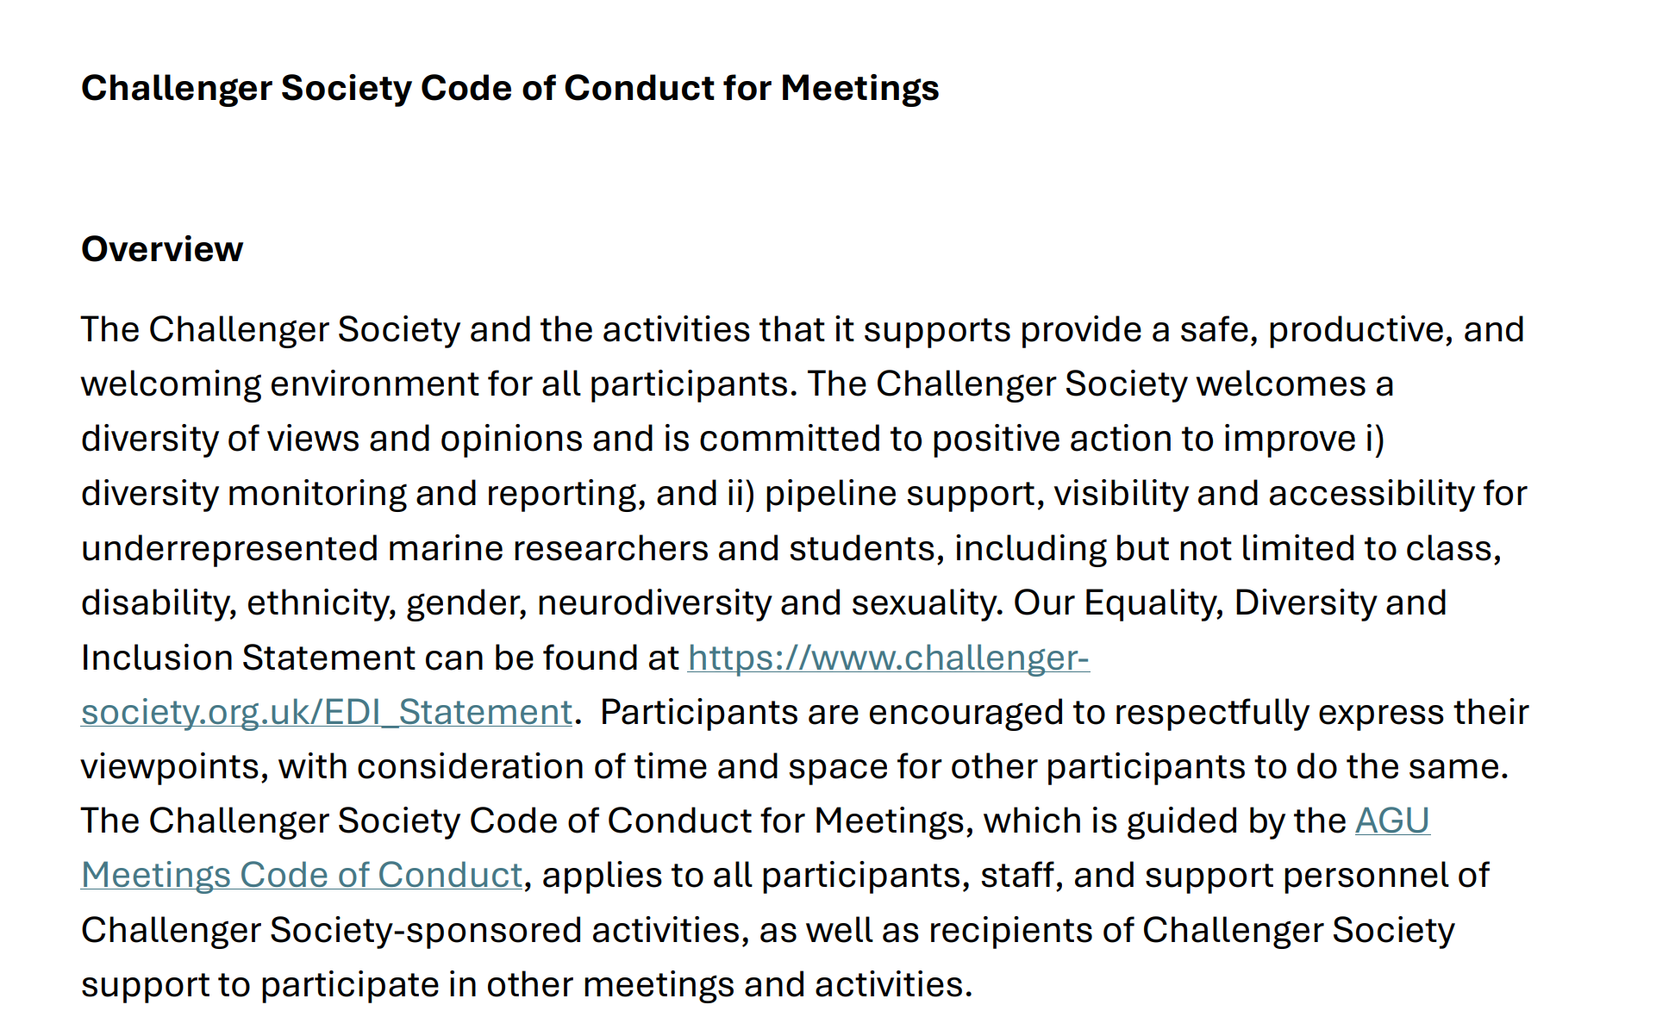

Slide 23
4. Portfolio reports
Education and Outreach

Slide 24
Education & Outreach
Development of Challenger Society online outreach
Established links with the newly formed Ocean Literacy SIG (at Challenger 2024 meeting) about communication strategy
YouTube channel to be launched early 2025
To run video making workshop either late 2024/early 2025, to be available to anyone in the Challenger Soc. To be run by Andy Crabb, Videographer at SAMS
Email to be sent out soon to recruit volunteers soon (and some already found!)
Outreach Materials
Development of a ‘bank’ of materials that can be sent to interested members of the society, to make outreach events easier and less time consuming
Can this be hosted on the website?

Slide 25
4. Portfolio reports
Membership and data protection

Slide 26
Membership and Data Protection Chelsey Baker
Updated membership statistics to reflect members (5th January 2024)
Small decrease post 2022 conference membership peak
Bank account issues in December 2023 mean we ceased removing expired memberships until further notice
Membership Type | Membership (05.01.2024) | Change in 2023
Full | 233 (53.3%) | -36
Retired | 43 (9.8%) | +1
Postgraduate student | 151 (34.6%) | -18
Corporate | 3 (0.7%) | -2
Honorary Life | 5 (1.1%) | No change
Library | 2 (0.5%) | No change
Total | 437 | -55

Slide 27
4. Portfolio reports
Industry liaison

Slide 28
Industry Liaison and Technology Terry Sloane
Liaison with industry to provide access to news, research opportunities, commercial opportunities and employment opportunities from within the ocean business community
Liaison with MSTG (Marine Science & Technology Group) trade association, The Society for Underwater Technology & IMarEST to provide a conduit for government organisations and policy makers from a lobbying, economic and business perspective and with the international oceanographic, hydrographic and meteorological instrument manufacturers and suppliers www.maritimeindustries.org www.imarest.org www.SUT.org
To strengthen the relationship between the organisations to provide a coherent business and science contact point to government and the media as well as early career members .
To provide the council and membership with information on developing technologies, “horizon scanning” sponsorship opportunities, industry support for research bids and technology search capabilities and to respond to requests for technical information
To provide industry with a view of the future requirements of the marine science community and to brief instrument manufacturers
To facilitate introductions between membership with respect to joint venture and licensing opportunities
To facilitate space at UK based exhibitions and reciprocal marketing activities
To raise sponsorship in support of our conferences and events – including the next meeting in Oban

Slide 29
4. Portfolio reports
EDIA Working Group

Slide 30

Challenger Society EDIA Working Group Activities 2023
Published paper on the Challenger Society EDIA working group (Oceanography. doi:10.5670/oceanog.2024.110)
2nd paper on modifying perceptions of fieldwork to improve diversity (Oceanography. doi:10.5670/oceanog.2024.131)
Initiated the inclusion of an EDIA representative on Challenger conference committees
Updated EDIA pages on Challenger Society website
Initiated an Unlearning Racism in the Geosciences Pod
Developed a Code of Conduct for Challenger Society meetings and conferences
Developed a process for reporting unacceptable behaviour at Challenger meetings and conferences
Engaged with the community, e.g., invited to the EDI Satellite Event at the Coastal Futures Conference

Slide 31
5. Treasurer's report and accounts
Alex Brearley

Slide 32
2023 Accounts YEAR ENDED 31 DECEMBER 2023
As of 2019 the CSMS hosts the finances of the UKPN, all numbers presented do not include the UKPN restricted funds.
The Society’s total income for 2023 was £29,963 an increase on 2022 (£28,171).
Total expenditure during 2023 was £36,419, an increase from 2021 (£ 32,442).

Slide 33
Other finance news
Cooperative bank is the new provider of the society’s current account after Barclays closed our previous current and savings accounts in November 2023. Everyone should now have been paid for any outstanding monies owed during the period of our banking hiatus.
Cambridge and Counties is the new provider of the society’s savings account to try and spread some of the risk going forward.

Slide 34
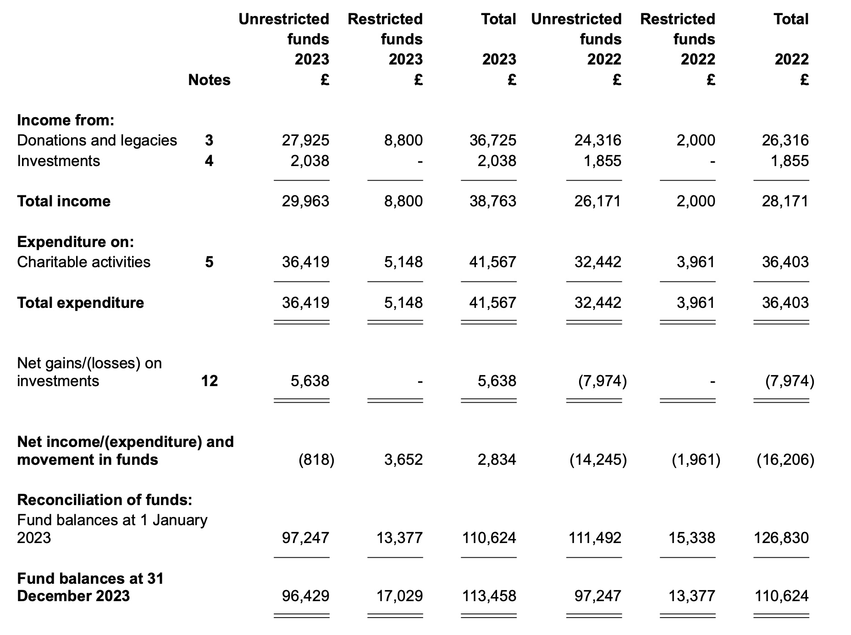
Donations and
membership fees
UKPN

Slide 35
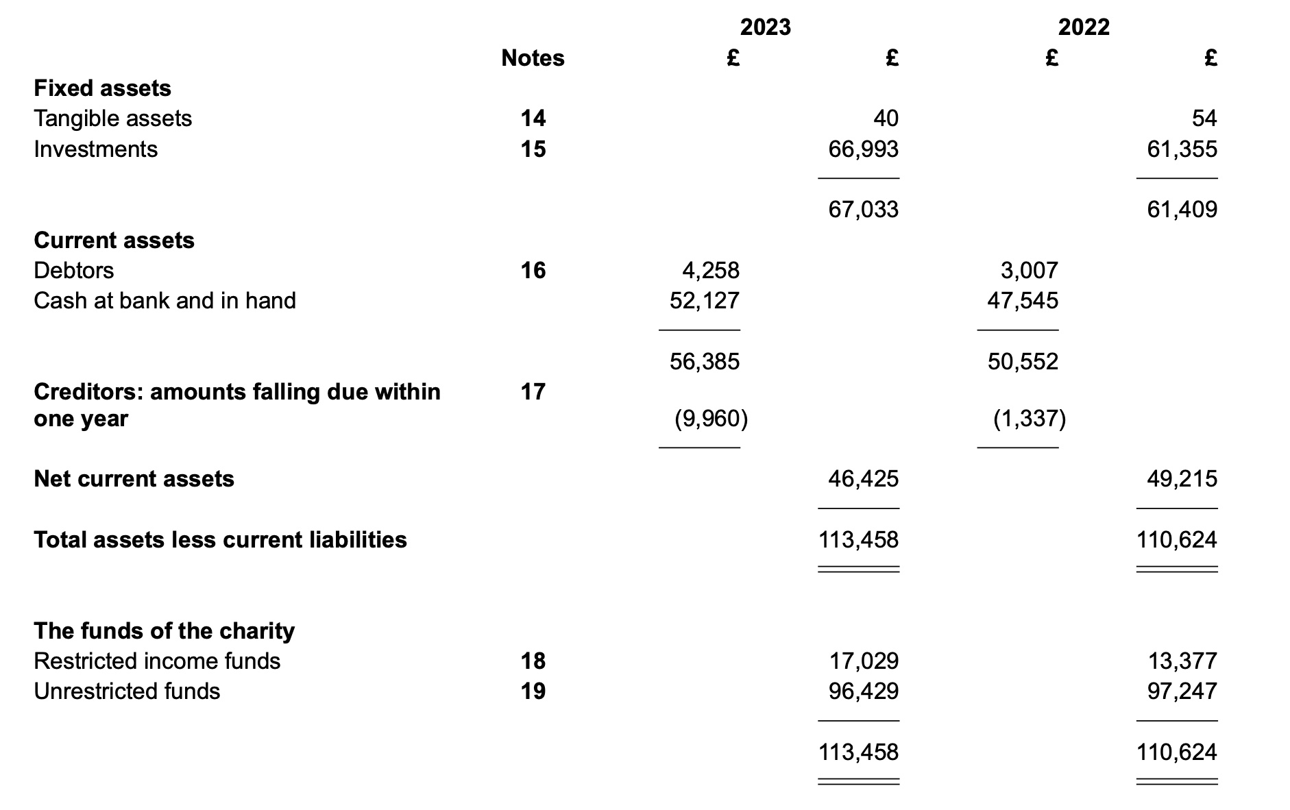

Slide 36
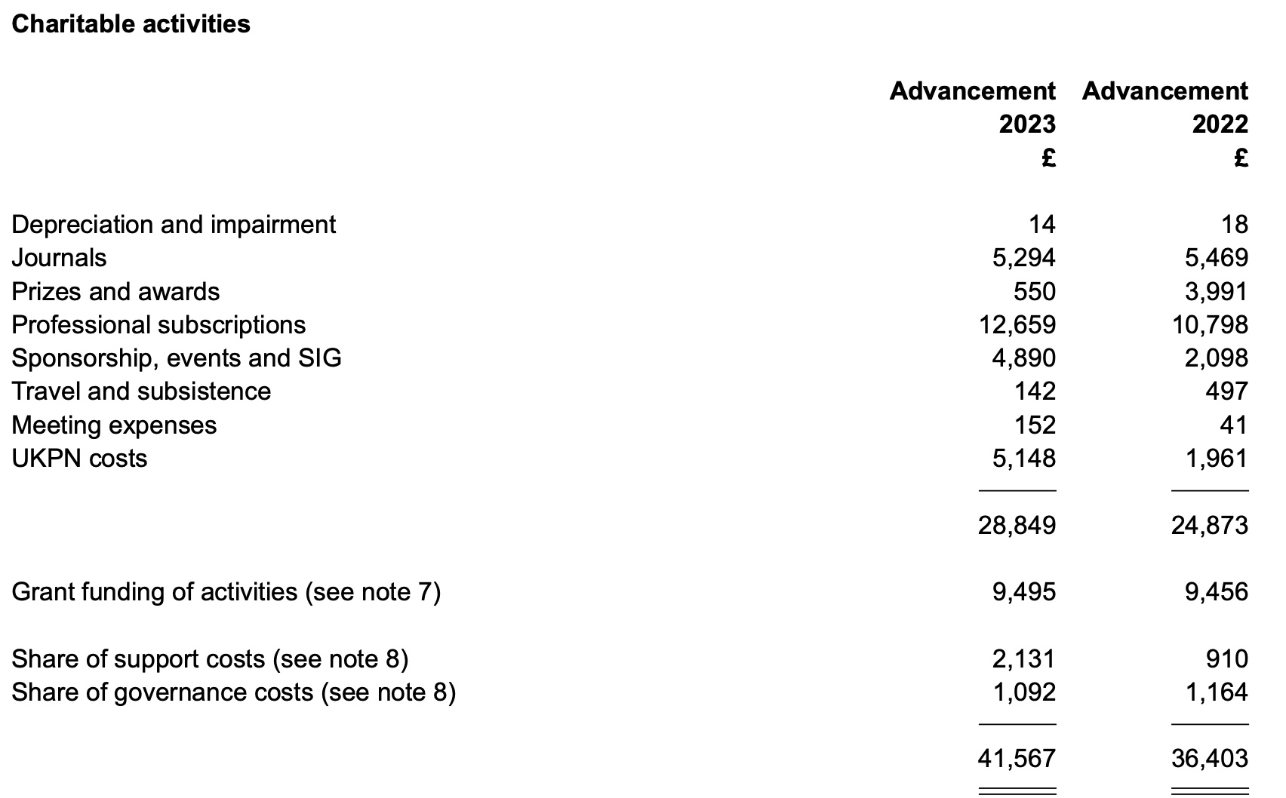

Slide 37
Questions on 2023 accounts ?
Proposer: Cecilia Liszka Seconder: Povl Abrahamsen

Slide 38
Reserves policy
The Society's reserves policy has been prepared through consultation with the Charities Commission guidance on reserves policies for small charities and has previously been agreed by council.
1) £15k would be placed in reserve to cover unforeseen emergencies
£30k (3 x £10k) would be placed in reserve to offset any potential future uncertainties in income (effectively the difference between annual subscriptions (£15k) and total income=expenditure ~£25k)
A contingency fund of £20k (equivalent to one year average annual expenditure over past decade) be held in reserve to meet unforeseen needs including unexpected opportunities which might arise for the society to further its objectives.
The reserved policy to be kept under review by council and presented for acceptance by the membership annually at the AGM

Slide 39
Reserves policy
In summary:
Council proposes a £65k reserve to be kept under annual review.
Current funds held, excluding UKPN, (31 December 2023) are £96,429 - this is a decrease from last year (£97,247)
Fixed assets (investment) £67,033
Current assets (Bank Accounts) £ 29,396

Slide 40
6. Appointment of auditors for Independent Financial Review

Slide 41
Accountants
In the interests of maintaining complete transparency in all of our affairs, the Challenger Society Council elected to continue to engage the services of an external auditor to perform an Independent Financial Review of the Society’s accounts each year.
We have retained the services of:
Argents Chartered Accountants
15 Palace Street
NORWICH
Norfolk
NR3 1RT

Slide 42
7. New and outgoing council members

Slide 43

Anthony Lucio - Portfolio for publications and website
Senior research engineer in the ocean technology and engineering group at NOC
Updating webpages
Upload and circulate Challenger Wave
Upload and circulate Ocean Challenge
Upload and circulate news items
Upload travel and stepping stones reports
Circulate communications via our mailing lists

Slide 44
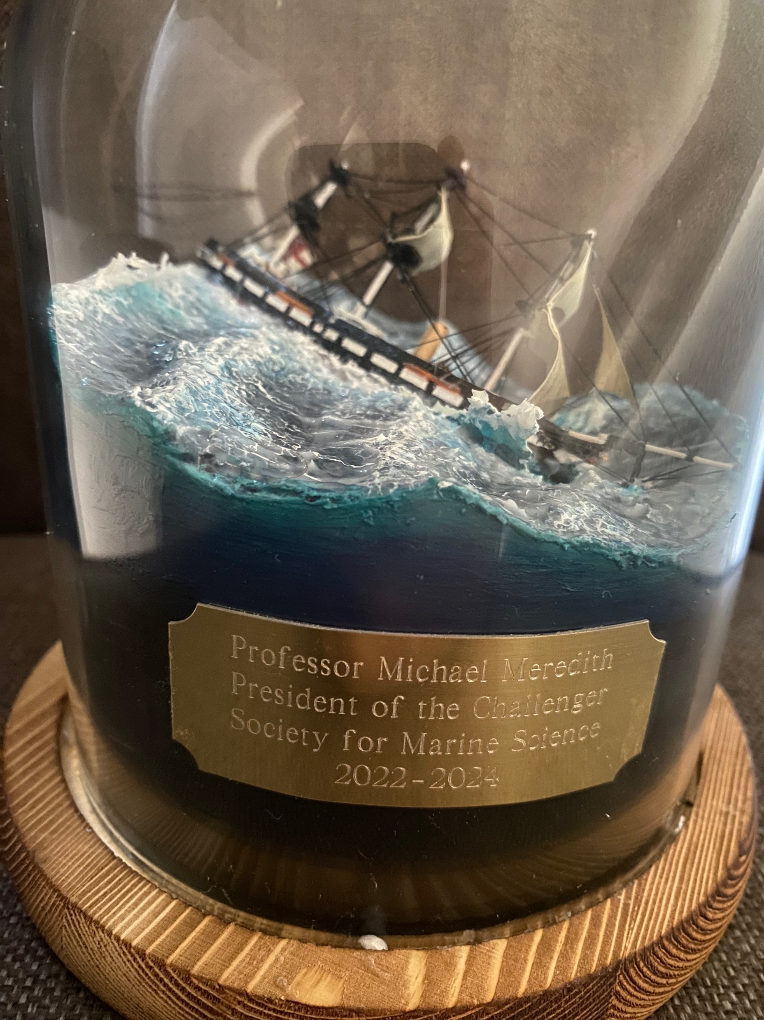
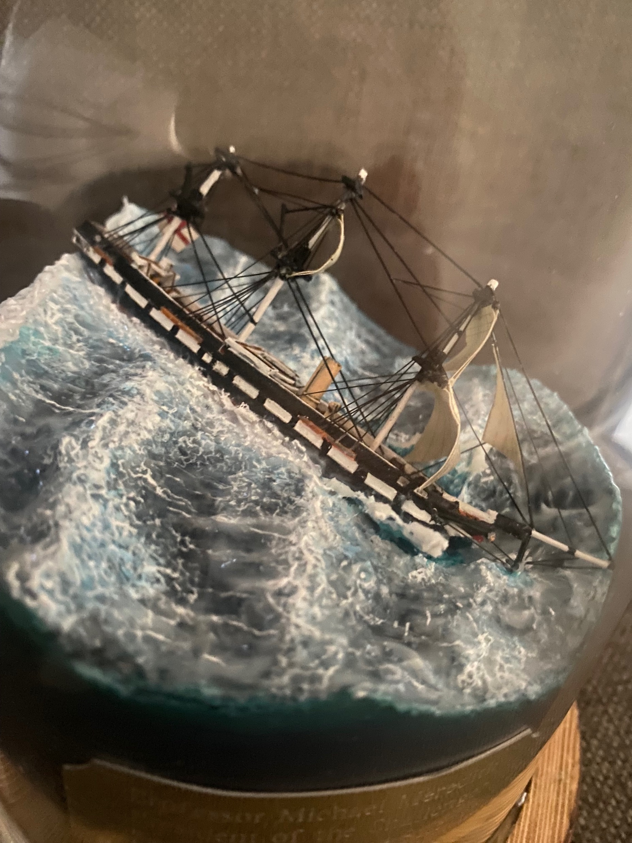
Changes to Council
Thanks to Mike Meredith who is leaving council
Welcome (again) to Maeve Lohan who is moving from Incoming President to Actual President!
Notes:
Mattias to update

Slide 45
8. AOB Changes to Articles of Association and Memorandum of Association

Slide 46
Changes to Memorandum and Articles of Association
The Memorandum of Association is a legal statement signed by all initial shareholders or guarantors agreeing to form the company
The Articles of Association are written rules about running the company agreed by the shareholders or guarantors, directors and the company secretary
These are documents needed by any company to operate →Any changes need to be approved by the membership.
We have made the changes to bring Challenger up-to-date and make the organisation fit for the future.
Change in Presidential Term to 3+2 years
Change to allow more Council members
Change in bank account signatories to three officers (President, Hon Sec, Treasurer)
Change in wording to allow officially for online/hybrid meetings and electronic documents
Change to allow for undergraduate members that do not pay a membership fee
Notes:
Mattias to update

Slide 47
Voting
Motion - to reduce the number of members required to be quorate to 15, if there are no legal restrictions
Proposed: Gillian Damerell Seconded: Angela Colling
Votes for: 8. Votes against: 4. Remainder abstained.
Meeting adjourned as <75% of required agreement
Adjourned meeting held 25/9/2024
Motion – to agree on special resolution to approve the new articles of association
Proposed: Matt Donnelly Seconded: Sophie Wilmes
Unanimously voted for. Motion passed

Slide 48
8. AOB
It was noted that this meeting was close to being quorate and we should think of ways to improve member engagement with AGM.
It was suggested to return to having the AGM at the Challenger Conference during Conference years.

